Slide 1
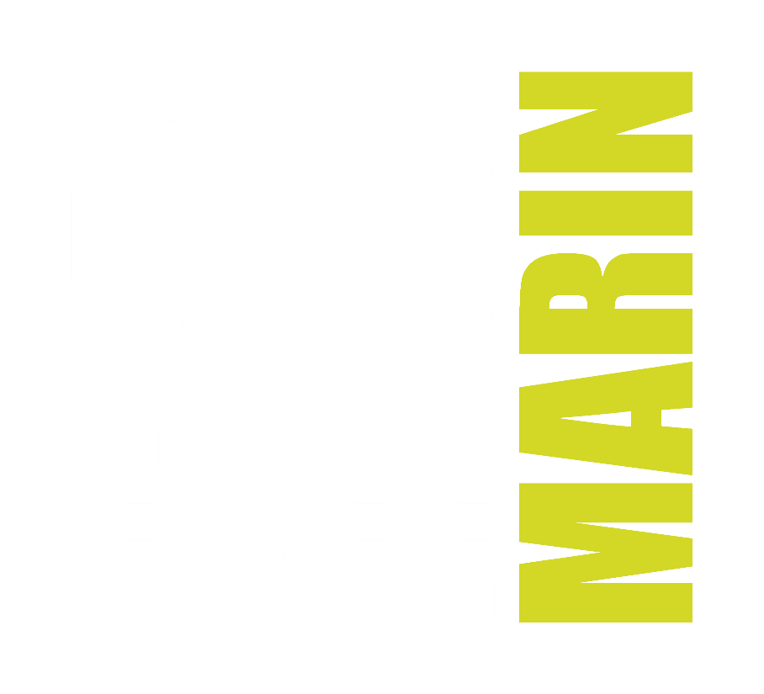
How to Save a Life with Naloxone
Name, Title

Slide 2
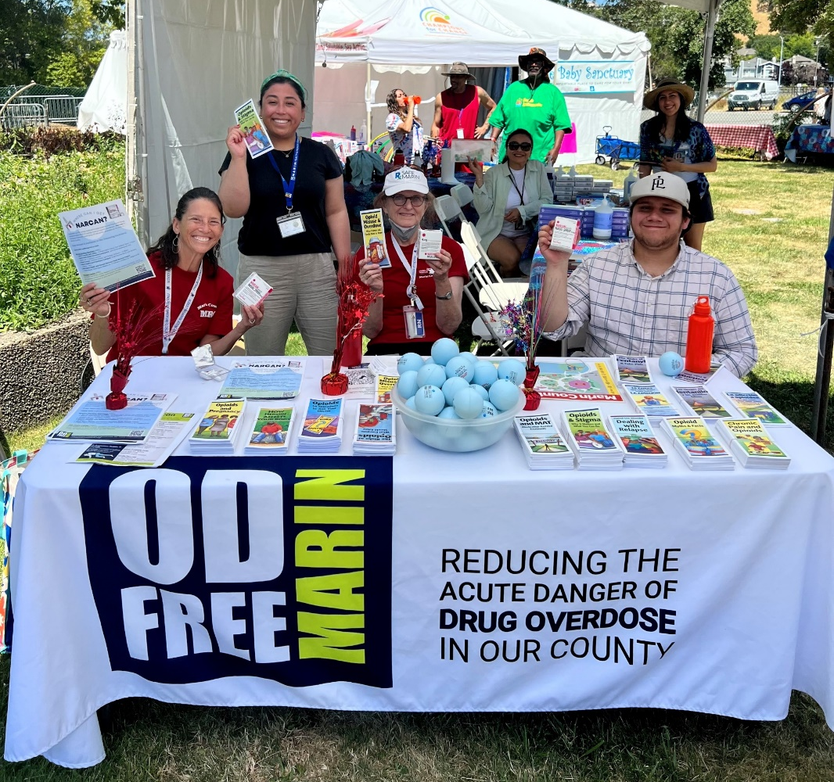
A Community-Based Coalition
Focused on reducing the risk of overdose in Marin County
Consists of 4 Action Teams, Steering Committee, Budget Committee and HHS staff
Utilizes evidence-based strategies aligned with CDPH priorities
Notes:
OD Free Marin is a community-based coalition working to end opioid overdose in Marin County.
We focus our efforts on expanding the distribution and use of Naloxone in Marin County and providing overdose prevention education to our community
Action Teams:
Education and Outreach
Justice System
Youth Action Team
Intervention, Treatment and Recovery
Photo: OD Free Marin Staff, Youth volunteers, and Marin Medical Reserve Corps Volunteers at 2023 Marin County Fair

Slide 3
Accidental overdose is the leading cause of death for residents under age 55 in Marin County
Most are due to opioids
Notes:
Opioid emergencies can happen anytime, anywhere.
Overdoses are preventable!
Having Naloxone Nasal Spray in your first-aid kit or carrying it with you on the go can save lives.
Source:
Marin County Public Health Department

Slide 4
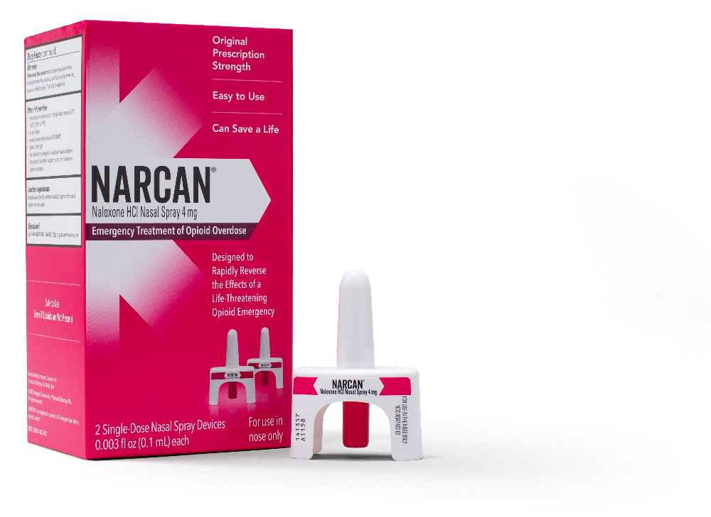
Naloxone Reverses an Opioid Overdose
Ready-to-use nasal spray
Can restore normal breathing within 2 to 3 minutes
Can be given safely to people of all ages
Will not harm someone if they are not overdosing
Anyone can carry naloxone
Notes:
Naloxone Nasal Spray is a life-saving medication that can reverse an overdose from opioids including heroin, fentanyl, and prescription opioid medications
Ready-to-use device containing a single 4 mg dose of naloxone hydrochloride.
Safe and will not harm someone if you give it to them and they are not overdosing on an opioid.
Can be given safely to people of all ages, from infants to older adults.
Anyone can carry Naloxone to help respond to an overdose.
Naloxone Nasal Spray is packaged individually in sealed blisters containing two single-dose nasal spray devices.
Naloxone can be quickly given through nasal spray (Naloxone in the nose, or through an injectable or auto-injector into the outer thigh or another major muscle.
Naloxone Nasal Spray:
For use in the nose only
Do not test nasal spray device before use
1 nasal spray device contains 1 dose of medicine
Each device sprays 1 time only
Sources:
https://www.cdc.gov/stopoverdose/naloxone/faq.html
https://www.cdc.gov/drugoverdose/featured-topics/naloxone.html
https://20797746.fs1.hubspotusercontent-na1.net/hubfs/20797746/Naloxone%20OTC%20Fact%20Sheet%20(1).pdf

Slide 5
You Can Save a Life with Naloxone
Recognize Signs of an Overdose
Call 9-1-1
Give Naloxone
Provide Aftercare
Provide Rescue Breaths
Notes:
If you think that someone is overdosing on an opioid or another substance:
Call 911 immediately.
Give naloxone as quickly as possible
Do not wait for emergency workers to arrive before giving naloxone.
Try to keep the person awake and breathing.
Lay the person on their side to prevent choking.
Stay with the person until emergency workers arrive.
Naloxone is a temporary treatment. More than one dose might be needed under some circumstances, especially if an overdose event involves illicitly manufactured fentanyl (IMFs).
Sources:
https://www.cdc.gov/drugoverdose/featured-topics/naloxone.html

Slide 6
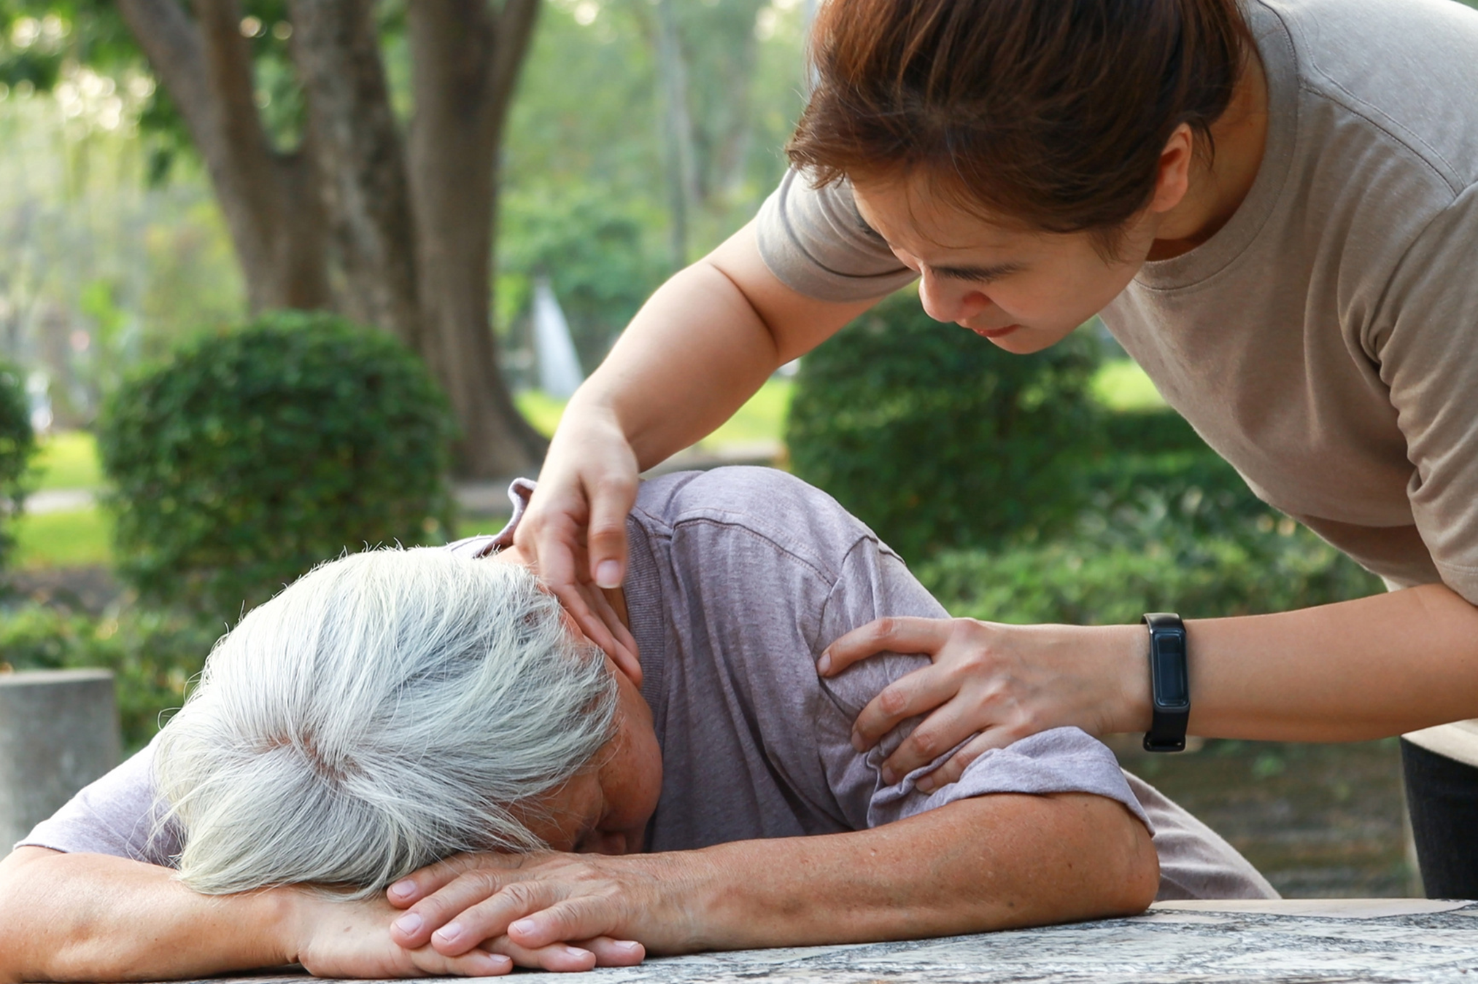
Recognize the Signs of an Overdose
Unconscious and can’t be woken up
Not breathing, or breathing slowly
Choking or gurgling sounds
Discolored skin
  Especially lips and nails
Small, “pinpoint pupils”
Limp body
Notes:
If you are unsure if the person is overdosing, there are obvious signs you can assess.
Is the person breathing?
Is the person responsive?
Do they answer when you ‘shake and shout’ their name?
Can the person speak?
How is their skin color (especially lips and fingertips)?
Lighter-skinned people: skin tone turns bluish-purple
Darker-skinned people: skin tone turns grayish or ashen.
How to check for responsiveness:
Try to stimulate them awake through verbal and physical stimulation.
Call their name
Rub your knuckles into the sternum
Rub your knuckles on their upper lip.
Pinch the back of their arm.
Sources:
https://www.cdc.gov/stopoverdose/naloxone/index.html
https://harmreduction.org/issues/overdose-prevention/overview/overdose-basics/responding-to-opioid-overdose/

Slide 7
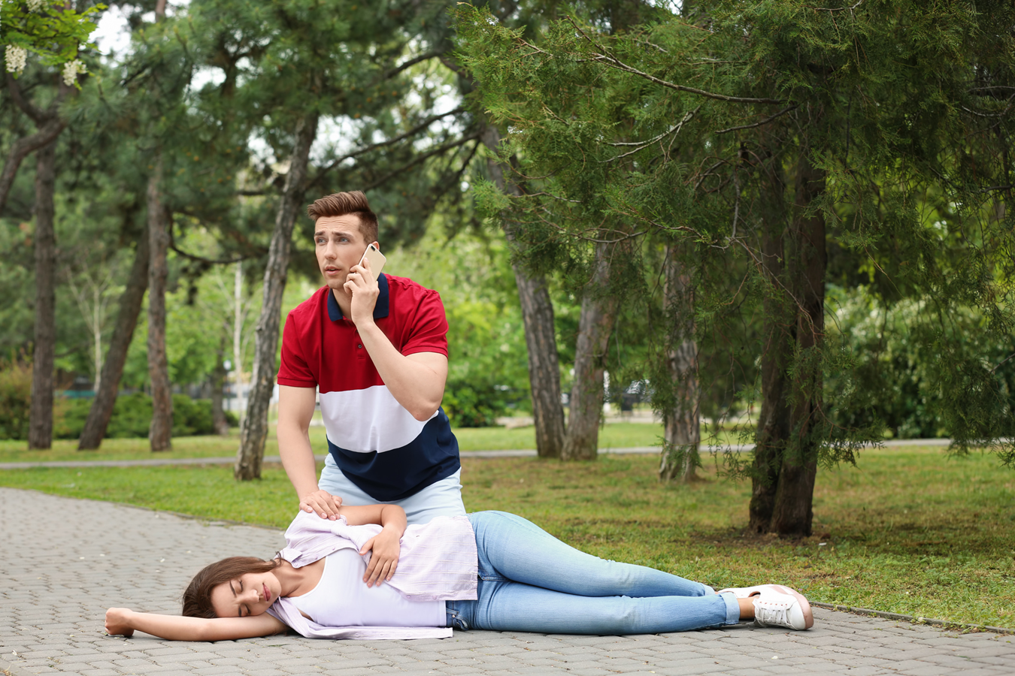
Call 9-1-1
Report that the person may have overdosed and is unconscious
Give your location
9-1-1 operator may guide you through steps
Always call 9-1-1 when naloxone is used
Overdose victims need medical care and monitoring after being revived
Notes:
Report that the person may have overdosed and is unconscious
Give the person’s exact location
Naloxone is not a substitute for emergency medical care
Naloxone ’s effect lasts for 60 to 120 minutes
Because most opioids last longer than that, the Naloxone may wear off before the effects of the opioids wear off and the person might go into an overdose again.
When making the call:
Tell the dispatcher exactly where you and the overdosing person are.
Give them as much information as possible so that they can find you (i.e., 3rd floor, or in the bathroom).
When the paramedics arrive, tell them what you know about what drugs the person may have been using—as much information as possible.
If the paramedics suspect opioids, they will give the victim an injection or intranasal dose of naloxone.
Sources:
https://www.cdc.gov/stopoverdose/naloxone/index.html
https://Naloxone.com/frequently-asked-questions
https://harmreduction.org/issues/overdose-prevention/overview/overdose-basics/responding-to-opioid-overdose/

Slide 8
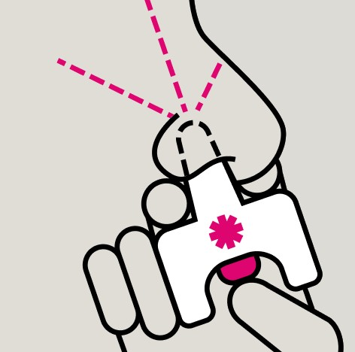
Give Naloxone Nasal Spray
Hold nasal spray with thumb on bottom of plunger
Insert nozzle into either nostril
Press plunger firmly to give dose
If the person does not wake up after 2-3 minutes, give another dose using a new device
Continue to give doses every 2-3 minutes until the person wakes up
Notes:
Hold the nasal spray device with your thumb on the bottom of the plunger
Insert the nozzle into either nostril
Press the plunger firmly to give the first dose
1 nasal spray device contains 1 dose
Wait 2-3 minutes after the 1st dose to give the medicine time to work
Give another dose in the alternate nostril using a new device if the person does not respond to the first dose
Continue to give doses every 2-3 minutes until the person wakes up or until medical assistance arrives.
More than one Naloxone Nasal Spray may be needed, this is why getting immediate medical care is critical
Sources:
https://20797746.fs1.hubspotusercontent-na1.net/hubfs/20797746/Naloxone%20Nasal%20Spray%204%20mg%20OTC%20Quick%20Start%20Guide.pdf
https://Naloxone.com/frequently-asked-questions
https://www.mayoclinic.org/drugs-supplements/naloxone-nasal-route/side-effects/drg-20165181?p=1

Slide 9
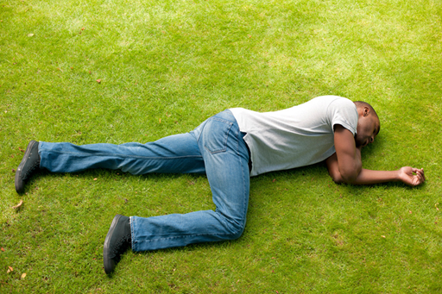
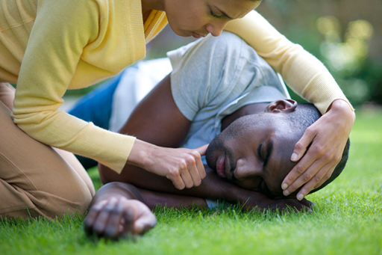
Provide Aftercare
If the person is breathing but unconscious place them in the recovery position
Turn them on their side and tilt their head back slightly to keep their airway open
Notes:
The recovery position is the specific positioning of an unconscious or unresponsive person to:
Keep their airway open and draining
To lower their chance of aspiration or choking
Kneel beside them. Make sure they are face up and straighten their arms and legs.
Take the arm closest to you and fold it over their chest.
Take the arm farthest from you and extend it away from the body.
Bend the leg closest to you at the knee.
Support the person's head and neck with one hand. Hold the bent knee and roll the person away from you.
Tilt the person's head back to keep the airway clear and open.
Once you have determined that the person has emerged from the overdose and the person is breathing regularly, place them in the recovery position to prevent aspiration or choking.
Effects of Naloxone vary lasting 60-120 minutes, stay with the person in case another dose of Naloxone is necessary
Sources:
https://www.healthline.com/health/first-aid/recovery-position#definition
CDPH Administering Naloxone: https://youtu.be/nurz9qPGKws?feature=shared

Slide 10
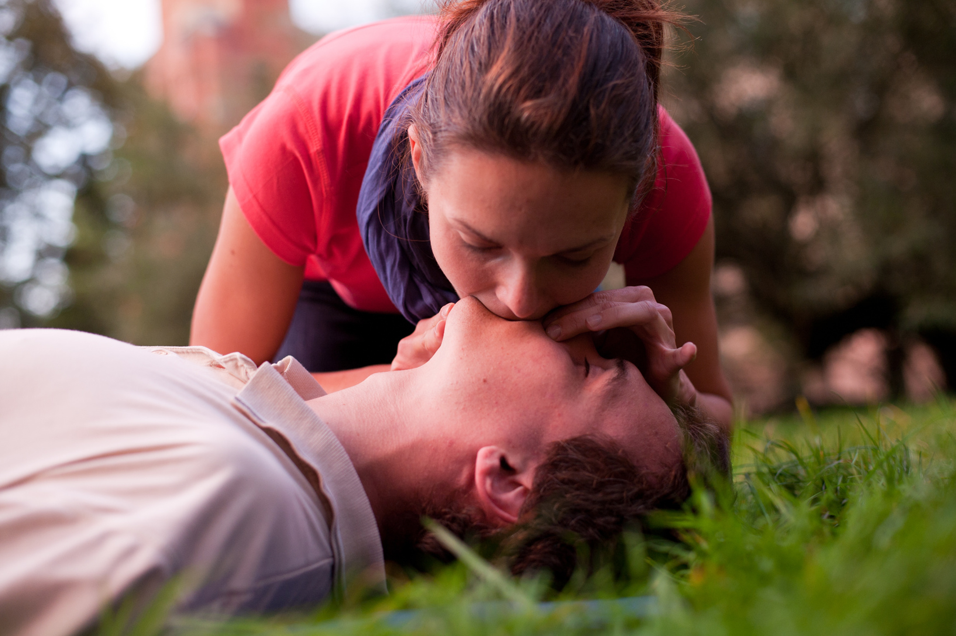
Provide Rescue Breathing
If the person is not breathing provide rescue breaths:
  Turn the person on their back
  Gently tilt their head back
  Pinch their nostrils shut
  Cover their mouth with yours and give a breath into their mouth
  Give a breath every 5 seconds or so, in your natural breathing rhythm
Notes:
Provide rescue breaths when someone does not respond to Naloxone and their breathing is absent or shallow.
Open their airway
Place your hand on their forehead.
Gently tilt their head back.
Use the fingers of your other hand to carefully lift their chin upward.
Give rescue breaths
Use the fingers of one hand to pinch the person’s nostrils shut. This helps to prevent air from escaping through their nose.
Cover their mouth with yours, forming a seal so that air doesn’t escape.
Give rescue breaths by gently breathing into their mouth. A rescue breath should last about 1 second. Aim to give a rescue breath every 5 to 6 seconds. This is about 10 to 12 breaths per minute.
Check to see if the person’s chest rises as you give the first rescue breath. If it doesn’t, repeat step 1 (open the airway) before giving additional rescue breaths.
Continue giving rescue breaths until emergency medical services (EMS) arrive or the person begins breathing normally on their own.
When someone has extremely shallow and intermittent breathing or has stopped breathing and is unresponsive, rescue breathing should be done as soon as possible because it is the quickest way to get oxygen into someone who has stopped breathing.
You may have heard that recent CPR guidelines recommend “hands-only CPR,” or only chest compressions instead of rescue breathing and chest compressions.
These guidelines are for layperson response to cardiac arrest, and NOT overdose.
It is still recommended that you perform rescue breathing for an overdose, where the primary issue is respiratory depression and not cardiac arrest.
Use a face shield if available to avoid germs and drug residue.
Sources:
https://www.redcrosslearning.com/course-bin/bls-healthcare-resuscitation/app/content/a/en-US/resources/TG-OpioidOverdose.pdf
https://www.healthline.com/health/rescue-breathing#how-to-do-it
https://harmreduction.org/issues/overdose-prevention/overview/overdose-basics/responding-to-opioid-overdose/

Slide 11
Remember the Most Important Steps!
Call 9-1-1
Give Naloxone
Notes:
Remember the most important steps during an opioid emergency,
Call 9-1-1
Give Naloxone.
Be ready. At home, at work or on the go with Naloxone Nasal Spray.
Anyone can save a life with Naloxone Nasal Spray

Slide 12
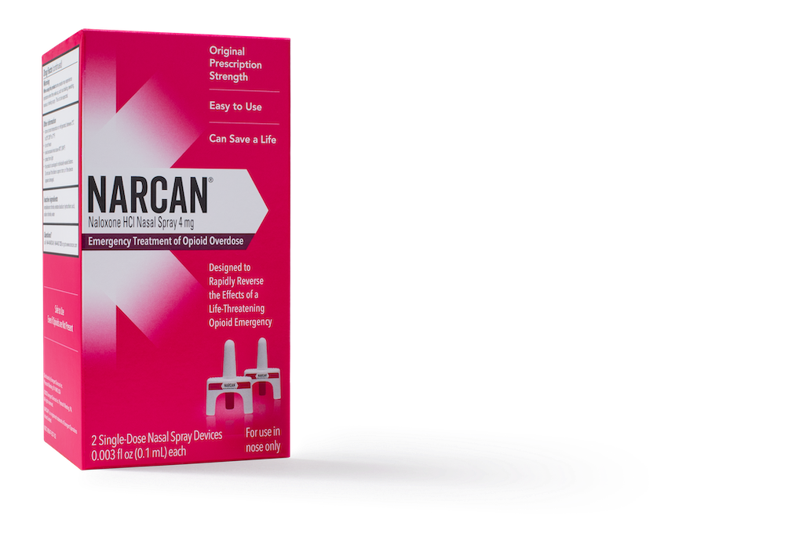
Naloxone is Available Over the Counter
Free at five vending machines in Marin County
May be covered by your medical insurance
Available at local pharmacies
Available at online retailers like Amazon
Retail Price is $45.99
Notes:
Free at five vending machines in the county
See our website for locations
Available at online retailers like Amazon and at local pharmacies for $45.99
May be covered by insurance

Slide 13

Resources at ODFreeMarin.org
  Free naloxone in Marin County
  Educators, Parents, Youth and Clinicians
  Marin County Data Dashboard
  Medication-Assisted Treatment
  Harm Reduction
  Join one of our Action Teams
Notes:
Where to get FREE Naloxone in Marin County
Vending Machine Locations
Other distribution sites listed
Resources for:
Parents
Youth
Educators
Clinicians
MAT resources
Harm Reduction
How to Get involved:
Sign up for an action team
Sign up to receive newsletter

Slide 14

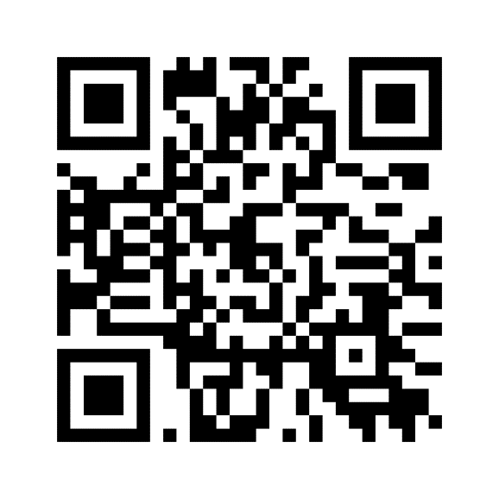
You Can Save a Life with Naloxone
Find it at odfreemarin.org/naloxone
Notes:
Find FREE Naloxone in Marin County using this QR code
Visit our website
Find us on Facebook, Instagram, LinkedIn
Contact us at info@odfreemarin.org
Sign up for our newsletter

Slide 15

FAQ
Notes:
Frequently Asked Questions

Slide 16
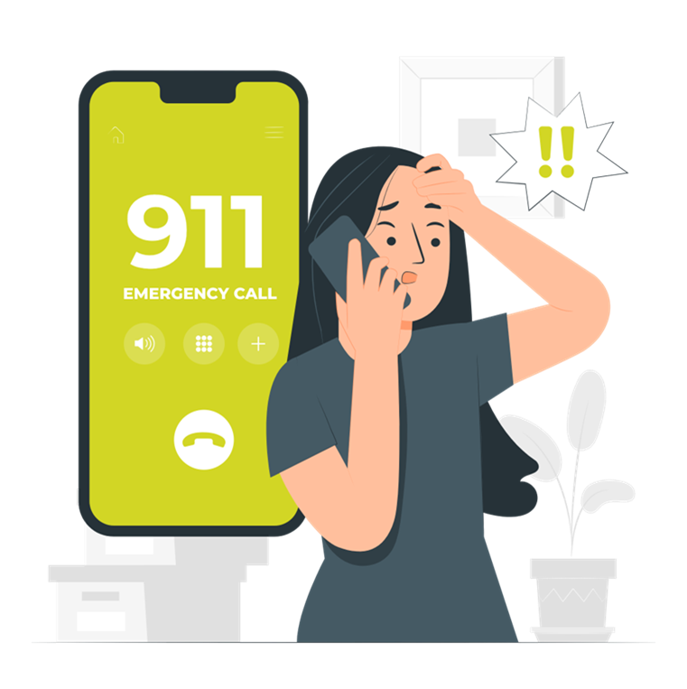
Do I need to call 9-1-1 if naloxone revives the overdosing person?
  Yes! Call 9-1-1 immediately!
  Naloxone is not a substitute for emergency medical care
  It does not stop the overdose for good.
Notes:
Yes! Call 9-1-1 immediately!
Naloxone is not a substitute for emergency medical care does not stop the overdose for good.
Naloxone may wear off before the effects of the opioids wear off and the person might go into an overdose again
Source:
https://Naloxone.com/frequently-asked-questions
https://harmreduction.org/issues/overdose-prevention/overview/overdose-basics/responding-to-opioid-overdose/

Slide 17
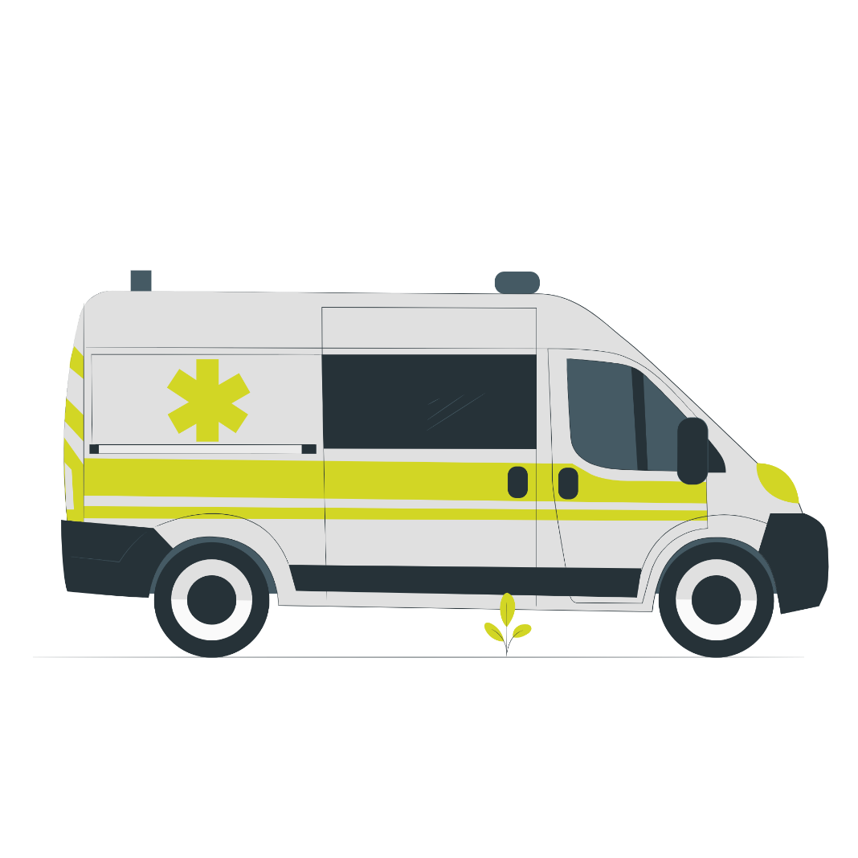
Am I protected from liability if I call 9-1-1 to report an overdose?
The Good Samaritan Law (Health & Safety Code § 11376.5) protects you from arrest, charge, and prosecution for being under the influence, or possessing drugs, or drug paraphernalia if you make a good-faith attempt to obtain medical care for someone experiencing a drug-related overdose
Notes:
California's Good Samaritan law protects those giving emergency medical care at the scene of a medical emergency, including giving Naloxone .​
The Good Samaritan Law (Health & Safety Code § 11376.5) protects you from arrest, charge, and prosecution for being under the influence, or possessing drugs, or drug paraphernalia if you make a good-faith attempt to obtain medical care for someone experiencing a drug-related overdose
For this protection to apply, you cannot obstruct medical or law enforcement workers. This law does not protect you if you are on parole, selling drugs, or forcing people to take drugs against their will.
Source:
https://leginfo.legislature.ca.gov/faces/codes_displaySection.xhtml?lawCode=HSC&sectionNum=1799.102.

Slide 18
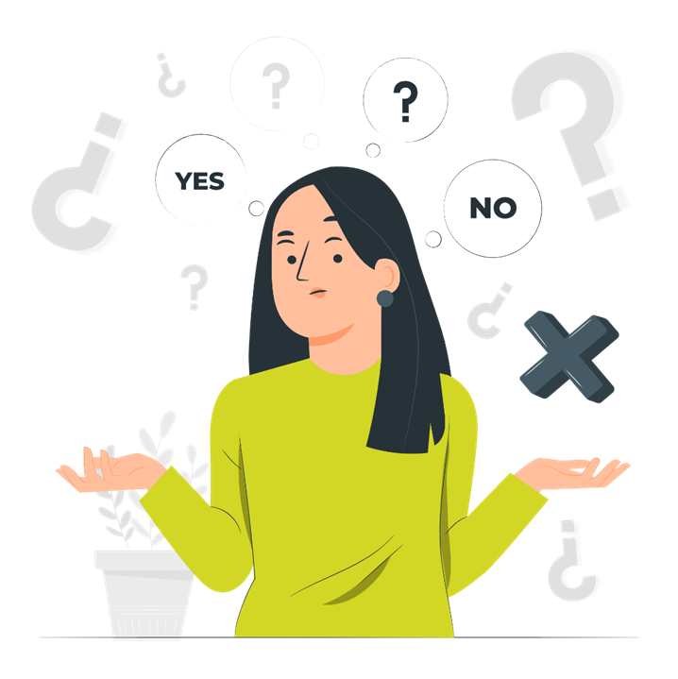
Can I use Naloxone on myself?
No, it is administered to someone after an overdose has occurred.
An overdosing person is likely unconscious, or their movement and breathing are restricted
Notes:
No, it is administered to someone after an overdose has occurred.
Because the individual who overdosed is likely unconscious or their movement and breathing are restricted, they would need assistance.
Source:
https://www.cdc.gov/stopoverdose/naloxone/faq.html#self-use

Slide 19
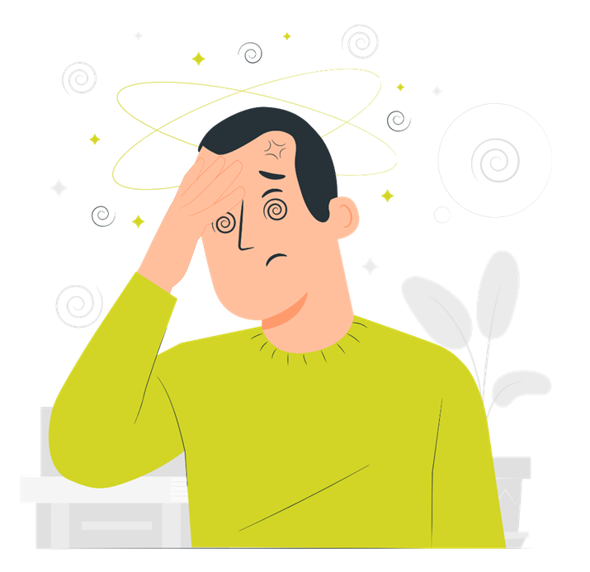
​Does Naloxone have side effects?
It can cause withdrawal symptoms
May include fever, anxiety, irritability, rapid heart rate, sweating, nausea, vomiting, tremors
Notes:
Naloxone can (but does not always) cause withdrawal symptoms or unpleasant physical reactions in people who are physically dependent on opioids.
Withdrawal symptoms may include fever, anxiety, irritability, rapid heart rate, sweating, nausea, vomiting, and tremors
Source:
https://www.cdc.gov/stopoverdose/naloxone/faq.html#self-use

Slide 20
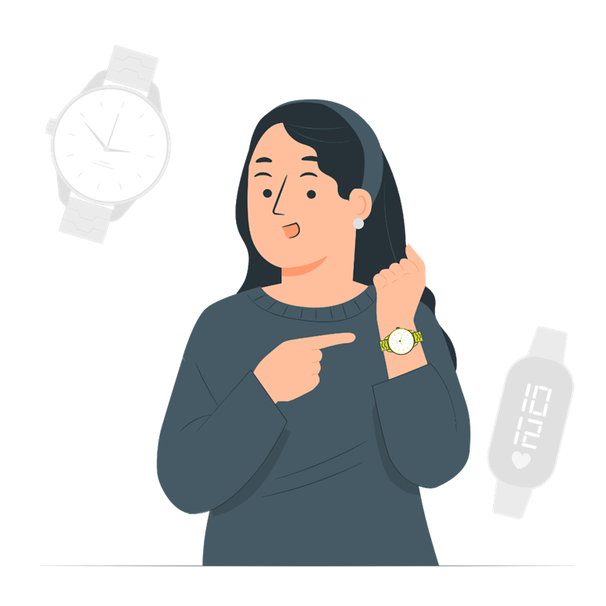
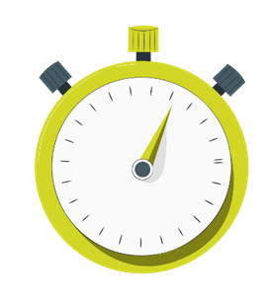
How long does Naloxone stay in your body?
Starts working in 2-3 minutes.
Lasts 60 to 120 minutes in the body
More than one dose may be needed
Notes:
Naloxone usually starts working within a few minutes and lasts for about 60 to 120 minutes in the body
More than one dose may be needed, this is why getting immediate medical care is critical.
Source:
https://Naloxone.com/frequently-asked-questions

Slide 21
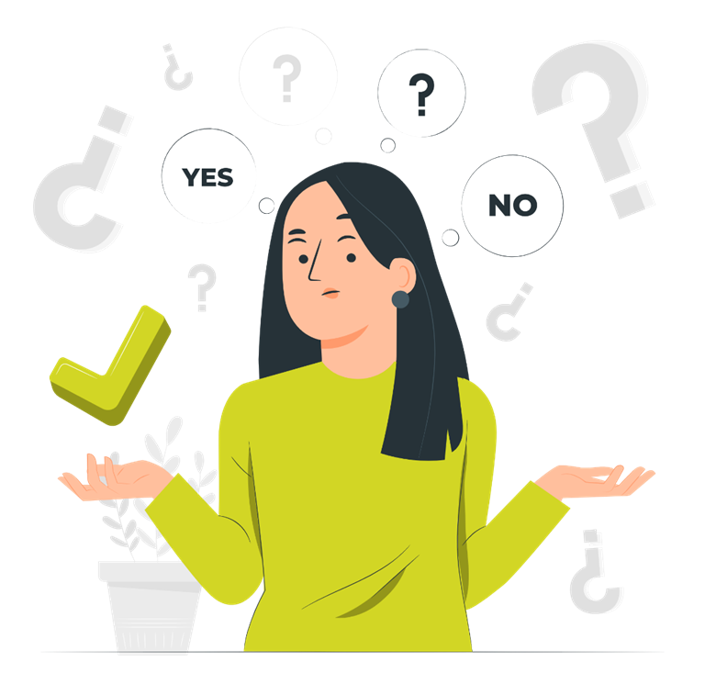
Does Naloxone expire?
Yes! Check the expiration date on the box.
It starts to lose its effectiveness after its expiration date, but it may be strong enough to reverse an overdose
Expired Naloxone can not hurt, so use it!
Notes:
Yes! Check expiration date on the box.
Like most other medications, Naloxone will start to lose its effectiveness after its expiration date. However, it may be strong enough to reverse an overdose if that is the only available kit.
It can not hurt, so use it!
Source:
https://harmreduction.org/issues/overdose-prevention/overview/overdose-faqs/

Slide 22
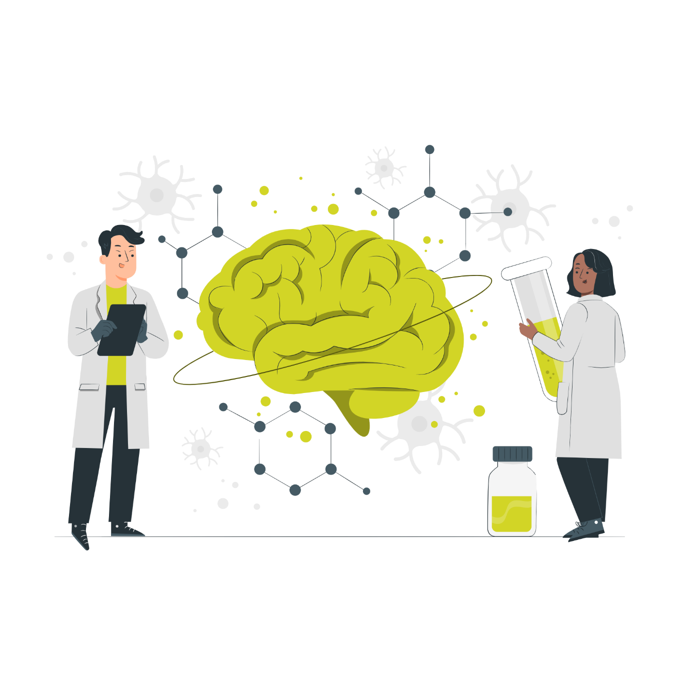
Opioids are a Highly Addictive Class of Drugs
Used legally for medical purposes and in the illegal drug market
Used to reduce pain
Produce pleasure or “high” feeling
Make you sleepy, relaxed
Slows breathing and heart rate
Breathing can stop in an opioid overdose which can lead to death
Notes:
Opioids are a class of drugs that work to relieve pain.
Opioids travel through the blood and attach to opioid receptors in brain cells. This blocks pain messages and can boost feelings of pleasure.
At lower doses, opioids may make you feel sleepy. But higher doses can slow your breathing and heart rate, which can lead to death.
The three main classes of opioids include:
Opiates or natural opioids from the seed pods of the poppy plant
Semi-synthetic opioids are half-natural, half-artificial. Scientists synthesize them in a lab from codeine or morphine
Synthetic opioids are completely developed in a lab
The terms “opiates” and “opioids” are often used interchangeably, but they don’t refer to quite the same thing.
Both are narcotics, which means they induce sleepiness or numbness. Many opiates and opioids also cause feelings of euphoria.
The key difference between them is how they’re made: Opiates are naturally occurring compounds, while opioids are either fully or partially synthetic (made by humans).
Natural opioids include: codeine, morphine, opium
Semi-synthetic: heroin, hydrocodone (Vicodin), hydromorphone (Dilaudid), oxycodone (OxyContin, Percocet), oxymorphone (Opana)
Synthetic: fentanyl (Actiq, Duragesic, Sublimaze), methadone (Dolophine, Methadose), tramadol (Ultram)
When opioid medicines are dangerous
What makes opioid medicines effective for treating pain also can make them dangerous.
At lower doses, opioids may make you feel sleepy. But higher doses can slow your breathing and heart rate, which can lead to death.
Sources:
https://www.healthline.com/health/substance-use/what-are-opioids#what-they-do
https://www.mayoclinic.org/diseases-conditions/prescription-drug-abuse/expert-answers/what-are-opioids/faq-20381270
https://nida.nih.gov/publications/drugfacts/prescription-opioids

Slide 23
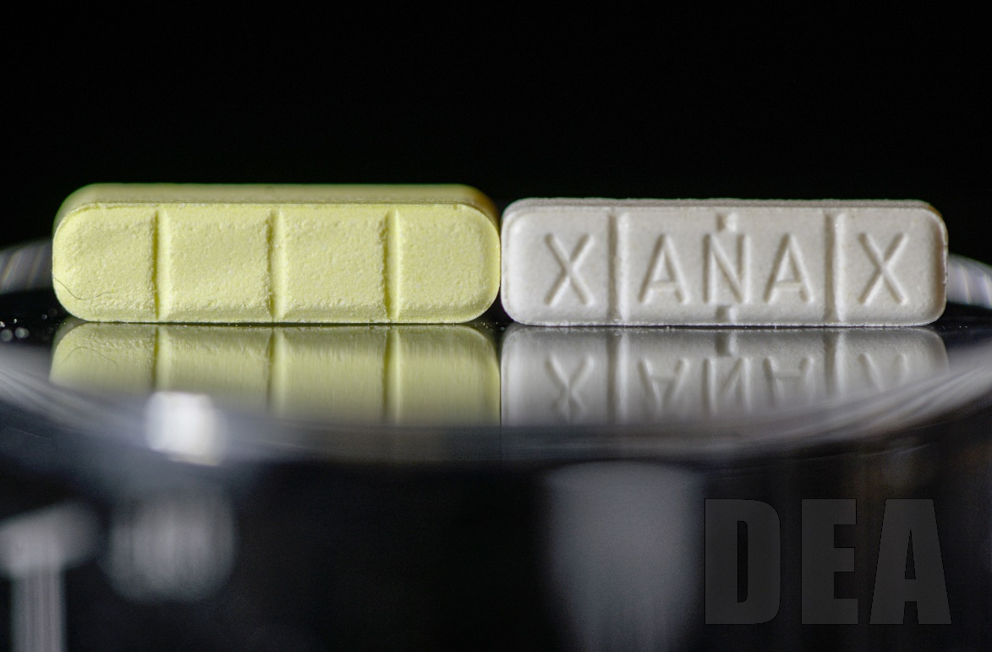
Fentanyl: “One Pill Can Kill”
50 times stronger than heroin and 100 times stronger than morphine
Illegally made fentanyl is mixed with drugs like heroin, cocaine, and methamphetamine
Made into pills that look like other prescription opioids
People may be unaware that their drugs are mixed with fentanyl
Can You Spot the Fake?
Notes:
Fentanyl is a synthetic opioid that is up to 50 times stronger than heroin and 100 times stronger than morphine
It comes in both pharmaceutical and non-pharmaceutical form
Illegally made fentanyl is mixed with drugs like heroin, cocaine, and methamphetamine and made into pills that are made to look like other prescription opioids.
Fentanyl-laced drugs are extremely dangerous, and many people may be unaware that their drugs are mixed with fentanyl.
Most recent cases of fentanyl-related overdose are linked to illegally made fentanyl, which is distributed through illegal drug markets for its heroin-like effect.
It is often added to other drugs because of its extreme potency, which makes drugs cheaper, more powerful, more addictive, and more dangerous. Almost impossible to tell if drugs are mixed with fentanyl; You cannot see, taste, or smell fentanyl
Fentanyl Myth: You cannot overdose simply by touching fentanyl. It must be introduced into the bloodstream or a mucus membrane for someone to feel the effects. While there are fentanyl patches that can be placed on the skin for pain management, this is not the formulation that’s cut into other substances.
Image from Drug Enforcement Administration (DEA)
Comparison between counterfeit Xanax (left) and authentic (right)
Sources:
https://www.cdc.gov/stopoverdose/fentanyl/index.html
https://www.flickr.com/photos/190205961@N07/51126058261/in/album-72157719245180132/
https://www.flickr.com/photos/190205961@N07/51126868790/in/album-72157719245180132/

Slide 24
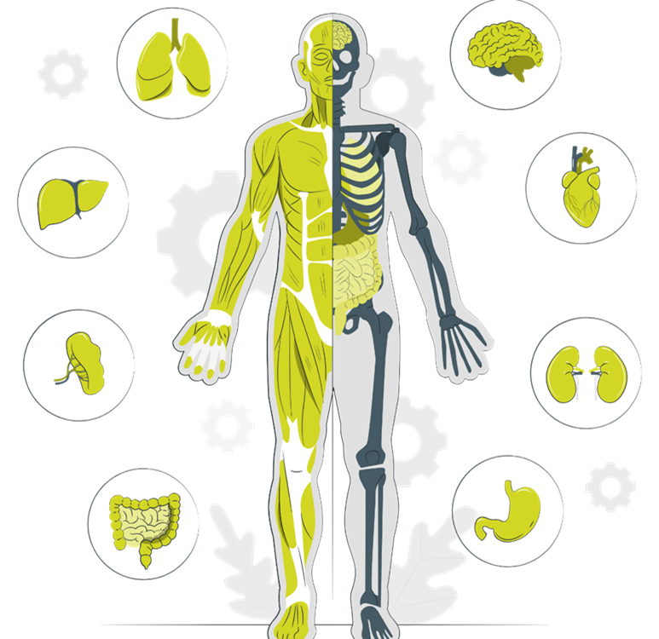
Opioid Overdose Affects Breathing
Toxic amount of a drug overwhelms the body
Opioids fit into specific receptors that also affect the drive to breathe
The oxygen levels in the blood decrease
Low oxygen stops vital organs and leads to unconsciousness, coma, and death
Notes:
Overdose happens when a toxic amount of a drug, or combination of drugs overwhelms the body
An overdose can occur with any substance– legal or illegal drugs
Opioid overdose happens because opioids fit into specific receptors that also affect the drive to breathe.
If someone can not breathe or is not breathing enough, the oxygen levels in the blood decrease.
Oxygen starvation eventually stops vital organs like the heart and then the brain.
This leads to unconsciousness, coma, and then death.
An overdose can happen whether drugs are taken intentionally or by accident.
Sources:
CDPH Administering Naloxone: https://youtu.be/nurz9qPGKws?feature=shared
https://harmreduction.org/issues/overdose-prevention/overview/overdose-basics/what-is-an-overdose/

Slide 25
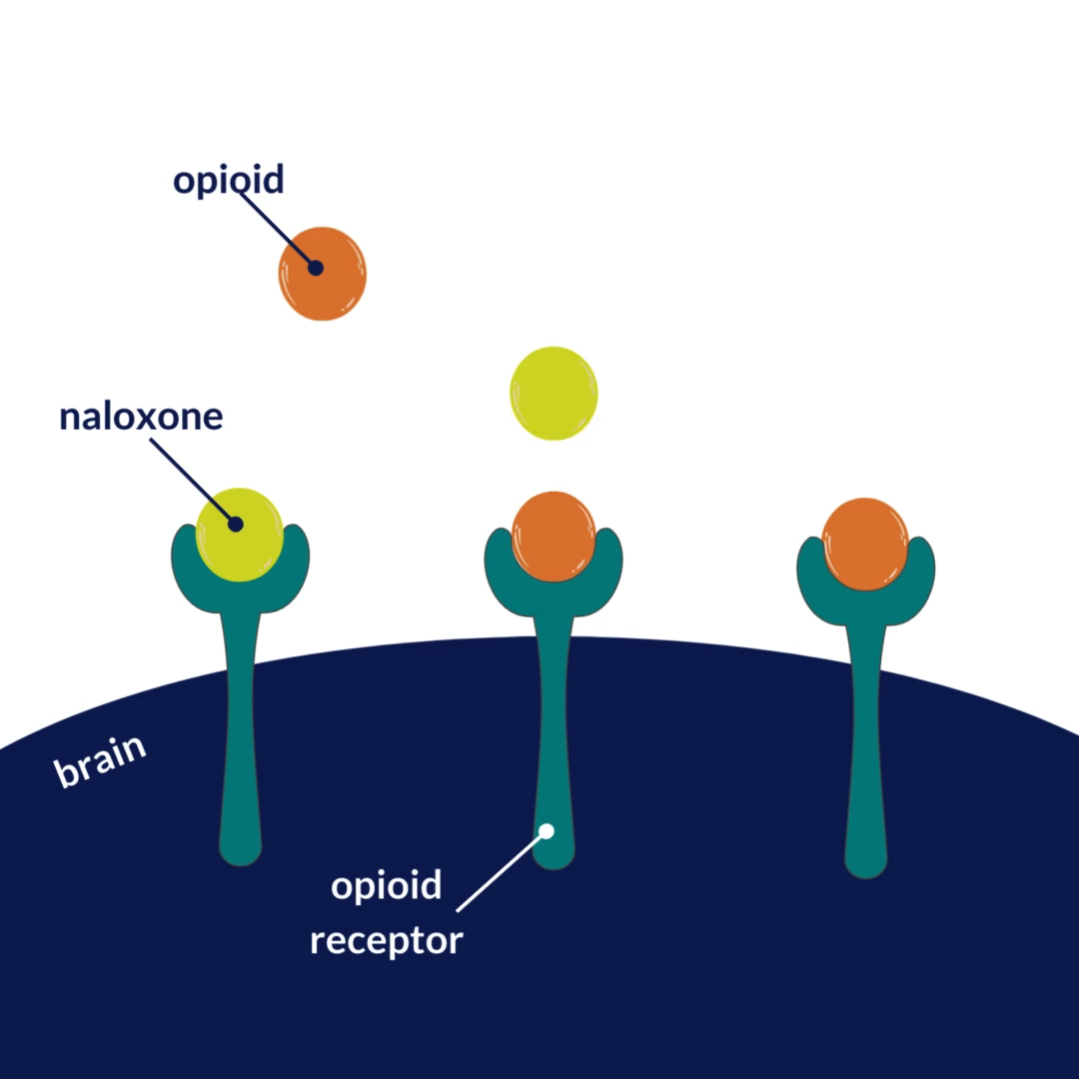
Naloxone is an Opioid Antagonist
Absorbed by nasal mucosa
Naloxone competes with opioids to bind with the same receptors in the brain
Reverses an opioid overdose in 2-3 minutes
Restores normal breathing
Notes:
Naloxone, the active ingredient in Naloxone Nasal Spray, is an opioid antagonist and competes with opioids to bind with the same receptors in the brain, reversing the effects of an opioid overdose in 2-3 minutes.
Naloxone only works if there are opioids involved with the overdose.
It cannot reverse an OD of cocaine, speed, benzos, alcohol, or other non-opioid-based drugs.
Naloxone can restore breathing in a person whose breath has slowed, or even stopped, because of opioid overdose.
This allows time for emergency medical help to arrive.
Naloxone nasal spray is sprayed in the nose and medicine is absorbed by the nasal mucosa.
It does not need to be breathed in by the lungs for the medicine to work.
Sources:
https://Naloxone.com/frequently-asked-questions
https://harmreduction.org/issues/overdose-prevention/overview/overdose-basics/responding-to-opioid-overdose/
https://www.cdc.gov/stopoverdose/naloxone/index.html

Slide 26
The Three Waves of Opioid Overdose Deaths
1990s
2010s
People addicted to opioids turn to illegal markets like heroin
2013
Synthetic opioids like fentanyl are popular due to potency and low cost
Today
Fentanyl is in counterfeit pills, or mixed with illicit stimulants
Overprescription of opioids and a rise in opioid addiction
Notes:
From California Department of Public Health
The United States is facing an overdose crisis
​​​​​​​​​​​​​​​​​In the U.S., there's a severe opioid crisis with over 83,000 opioid-related overdose deaths per year, more than 90% of which involve fentanyl.
This same issue is happening here in California:
Nearly 7,000 people died from opioid overdose in 2022
87% of those deaths involved fentanyl
More than 21,000 emergency room visits were related to opioid overdose​s
In the last two decades, the opioid crisis has killed over 564,000 people from overdose deaths alone.
Over 150 people die every day because of synthetic opioids like fentanyl.
Since 1999, the US has been faced with an evolving crisis of opioid addiction, overdose and death.
1990s
Big Pharma markets prescription opioids like OxyContin as less addictive than older drugs without any scientific evidence in support of that claim, leading to the vast overprescription of opioids and a rise in opioid addiction, overdose and death.
2010
The medical industry begins to realize the dangers of prescription opioids; those addicted to opioids turn to illegal markets like heroin instead, triggering a second wave of overdoses and deaths.
2013
Synthetic opioids like fentanyl grow more popular due to their potency and relative cheapness, sending overdose deaths skyrocketing.
2023
Emerging threats include fentanyl being cut with xylazine or mixed with illicit stimulants like methamphetamine or cocaine—driving an even deadlier wave of overdoses and deaths.
Source: https://www.cdph.ca.gov/programs/ccdphp/opioids/pages/landingpage.aspx?utm_source=dc_gs&utm_medium=paidsearch&utm_campaign=dc_ope_governor_mc_en&utm_term=na_na&utm_content=general&gad_source=1
CDC
From 1999-2021, nearly 645,000 people died from an overdose involving any opioid, including prescription and illicit opioids.
This rise in opioid overdose deaths can be outlined in three distinct waves.
The first wave began with increased prescribing of opioids in the 1990s, with overdose deaths involving prescription opioids (natural and semi-synthetic opioids and methadone) increasing since at least 1999.
The second wave began in 2010, with rapid increases in overdose deaths involving heroin.
The third wave began in 2013, with significant increases in overdose deaths involving synthetic opioids, particularly those involving illicitly manufactured fentanyl. The market for illicitly manufactured fentanyl continues to change, and it can be found in combination with heroin, counterfeit pills, and cocaine.
Many opioid-involved overdose deaths also include other drugs.
Source:
https://www.cdc.gov/opioids/basics/epidemic.html

Slide 27
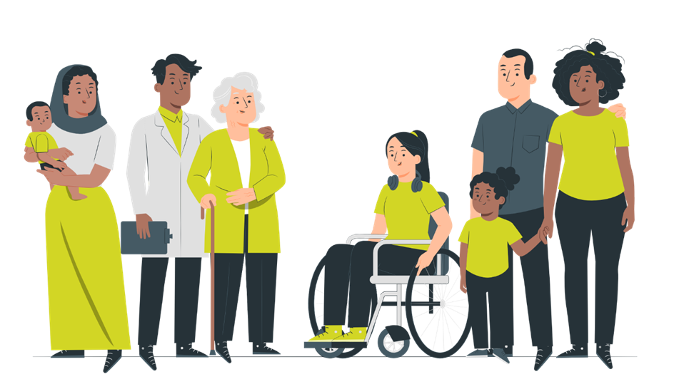
Who is at Risk of an Opioid Overdose?
People experimenting with drugs
People with opioid use disorder
People prescribed opioids
Your family or friends
It can happen to anyone!
Notes:
Opioids are a critical part of medical treatment for various health conditions but accidents can happen.
Learn to recognize the symptoms of opioid overdose because you may not know that your family or friends are taking opioids
3 million US residents and 16 million individuals worldwide have had or currently suffer from opioid use disorder.
80% of overdose deaths occurred inside a home (based on a CDC Vital Signs Report)
Sources:
https://Naloxone.com/opioid-education
https://www.cdc.gov/stopoverdose/naloxone/index.html

Slide 28
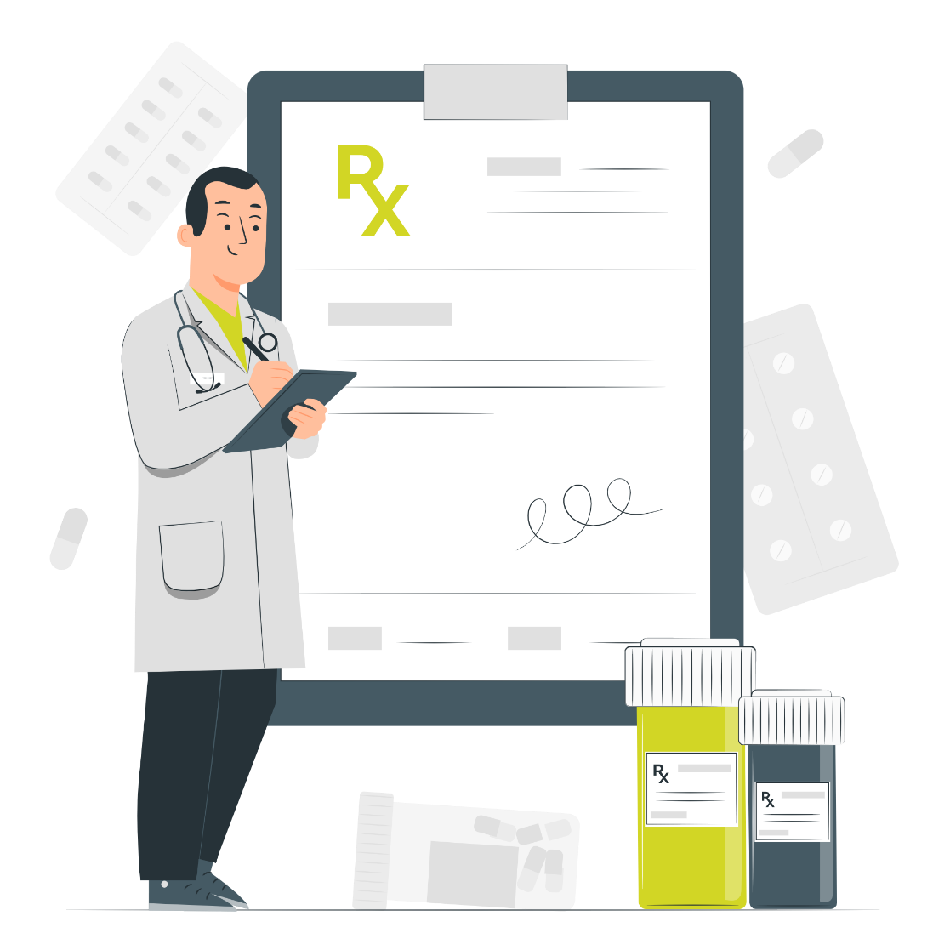
You Can Prevent an Opioid Overdose
Keep naloxone readily available on you and at home
Take medicine as prescribed by your medical provider
Never take someone else’s medication
Store your medication out of reach
Safely dispose of unused medication
Notes:
Always follow the instructions you receive with your medication. Ask your practitioner or pharmacist if you have questions or are unsure of how to take your medication.
The following tips can help you or a loved one avoid opioid overdose:
Keep Naloxone readily available on you and at home
Take medicine as prescribed by your practitioner
Never take someone else’s medication
Prevent children and pets from accidental ingestion by storing your medication out of reach.
Dispose of unused medication safely
Opioid overdose can occur even with prescription opioid pain relievers and medications used in treating SUD such as methadone and buprenorphine.
In addition, individuals using naltrexone for MOUD have a reduced tolerance to opioids, and therefore, using the same, or even lower doses of opioids used in the past, can cause life-threatening consequences.
Sources:
https://www.samhsa.gov/medications-substance-use-disorders/medications-counseling-related-conditions/opioid-overdose#:~:text=The%20following%20tips%20can%20help%20you%20or%20a,...%206%20Dispose%20of%20unused%20medication%20safely.%20

Slide 29

Tranq is an Emerging Threat in Marin
Xylazine is an animal tranquilizer
Mixed with illegal drugs such as cocaine, heroin, and fentanyl
Can slow or stop breathing, and cause serious skin infections
Naloxone will not reverse the effects of xylazine
Xylazine is often used with opioids like fentanyl, so Naloxone should always be given
Notes:
A drug intended for use in animals (horses, cattle, etc) as a sedative and pain reliever.
Also known as Tranq or Tranq Dope
It is not safe for humans and may result in life-threatening reactions, like slowing or stopping breathing, and serious skin infections
Illegal drugs such as cocaine, heroin, and fentanyl can be mixed with xylazine, either to enhance drug effects or increase street value by increasing their weight.
Xylazine has been increasingly detected in the regional illicit opioid supply.
Naloxone will not reverse the effects of xylazine. However, because xylazine is often used with opioids like fentanyl, Naloxone should still be given.
Severe, necrotic skin ulcerations, sometimes requiring amputations, have also been reported with repeated exposure to xylazine.
Due to its impact on the opioid crisis, fentanyl mixed (adulterated) with xylazine has been declared an emerging threat by the White House’s Office of National Drug Control Policy. On July 11, 2023, the White House released a National Response Plan to address the emerging threat of fentanyl mixed with xylazine.
April 27, 2023, Marin County PUBLIC HEALTH ADVISORY: Xylazine Presence in Illicit Drug Supply
Source:
https://www.cdc.gov/drugoverdose/deaths/other-drugs/xylazine/faq.html
https://www.marinhhs.org/sites/default/files/files/public-health-updates/advisory_-_xylazine_presence_in_illicit_drug_supplymw.pdf
https://www.cdph.ca.gov/Programs/CCDPHP/sapb/CDPH%20Document%20Library/Xylazinefactsheet_.pdf
https://www.whitehouse.gov/ondcp/briefing-room/2023/04/12/biden-harris-administration-designates-fentanyl-combined-with-xylazine-as-an-emerging-threat-to-the-united-states/

Slide 30
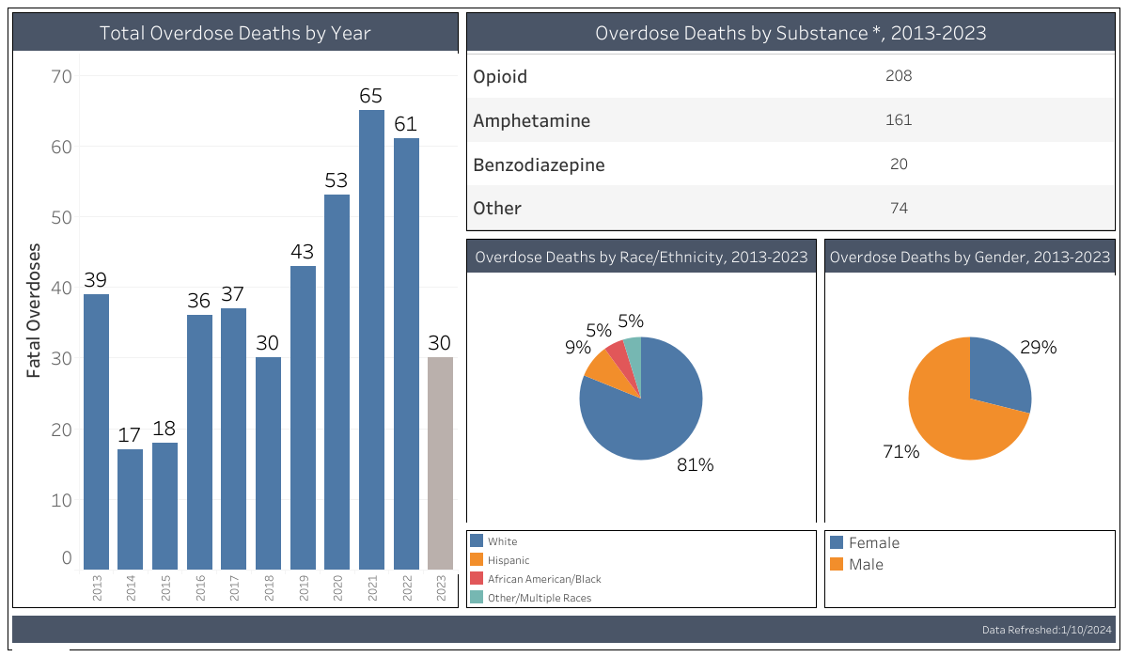
Data-Driven Strategies Prevent Overdoses
View Marin County overdose data on our Data Dashboard
Data track trends and provide information for shared understanding and action across our County
Marin County Public Health tracks fentanyl and other illicit drugs in local wastewater
Notes:
OD Free Marin strives to prevent overdoses through data-driven strategies and community collaboration.
Source:
https://odfreemarin.org/data-dashboard/
https://www.kqed.org/science/1982720/marin-health-officials-track-illicit-drug-use-by-testing-wastewater

Slide 31
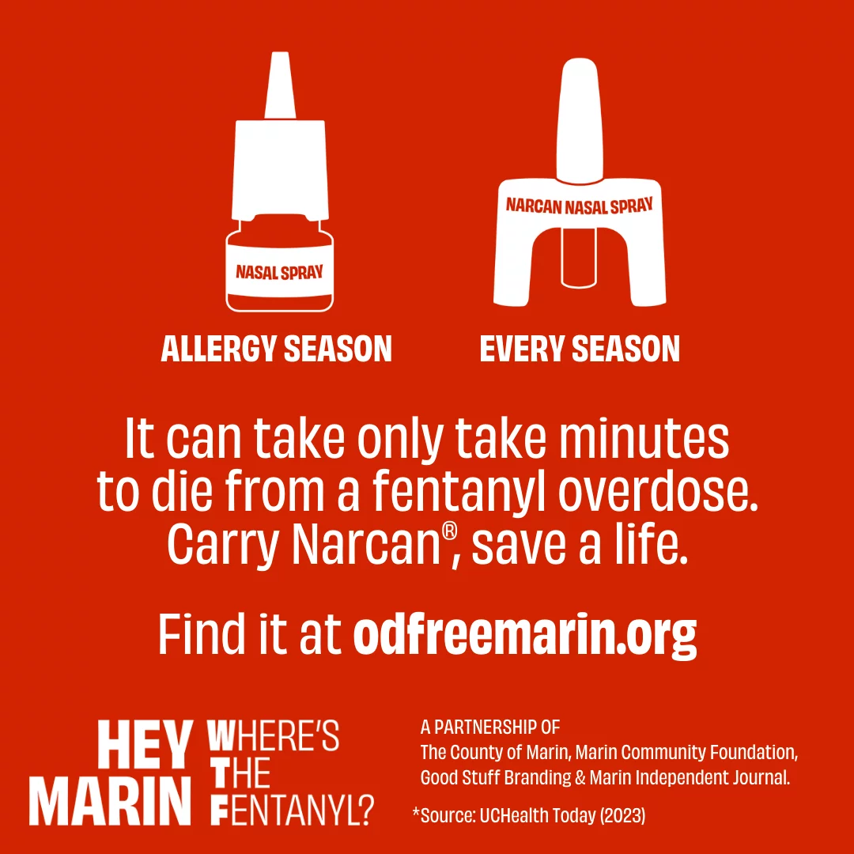
Hey Marin, Where’s The Fentanyl?
Fentanyl awareness campaign
Toolkit for partners:
  Social media graphics, video reels with captions in English and Spanish
  Free customizable materials with ready-to-use templates
Collaboration between Marin Community Foundation, Independent Journal, Good Stuff Partners, and the County of Marin
Notes:
Print, radio, and social media campaign
The campaign focuses on three priorities:
raising awareness
increasing access to Naloxone
removing barriers to substance use treatment
Toolkit is available on our website: odfreemarin.org/wheres-the-fentanyl/
Tag us on Instagram, Facebook, and LinkedIn, and use our hashtags #odfreemarin #heymarin #holamarin #wheresthefentanyl #dondeestaelfentanilo

Slide 32
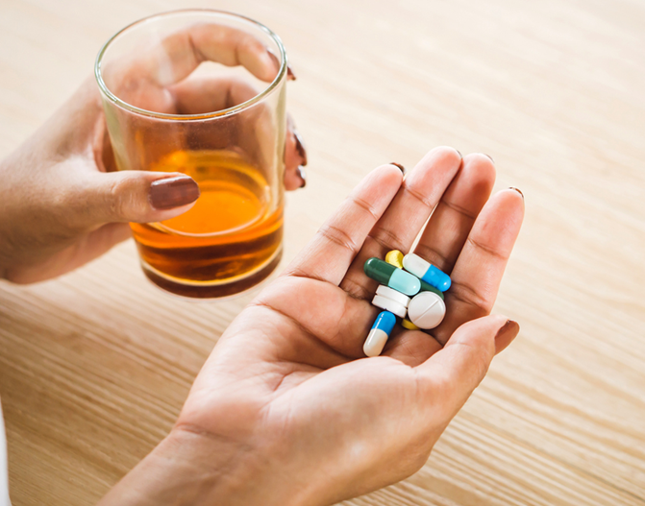
Opioid Overdose Risk Factors
Lower tolerance from lack of prior use
Mixing drugs
Previous history of overdose
Physical health
Variation in strength and purity of drug
Switching mode of administration
Using alone
Notes:
Tolerance shift
Individuals with decreased tolerance due to recent release from incarceration, drug treatment/detoxification, hospitalization, abstinence, or intermittent nondaily use of opioids are at risk.
Mixing drugs
Combining opioids with other legal or illegal substances may enhance their effects and thus increase the overdose risk. Combining opioids with alcohol, benzodiazepines, barbiturates, or other psychotropic medications, such as antidepressants, is very dangerous.
Previous history of overdose
Individuals who have had a prior overdose event at any point in their lifetime are more likely to experience another overdose.
Physical health
If a person’s body is already burdened with an acute or chronic illness (e.g. asthma, other substance use disorder, HIV, etc.), the person is more vulnerable to overdose.
Variation in opioid strength/content
Illegally purchased substances vary greatly in their strength (e.g., one bag of heroin or fentanyl might not be as strong as another bag even when obtained from the same seller).
Switching from snorting/smoking to injection
How a person ingests a substance plays an important role in overdose risk. Injecting is usually riskier than other forms of administration, but an overdose can also occur when a person just swallows a single pill.
Using alone
If no one is there, no one can help. Overdose reversal can be effective 1–3 hours after use of the opioid, but the risk of fatality is high if the user is alone.
Sources:
https://www.apa.org/topics/substance-use-abuse-addiction/opioids-overdose-risks
CDPH Administering naloxone: https://www.youtube.com/watch?v=nurz9qPGKws

Slide 33

Lower Your Risk of an Opioid Overdose
Have a trusted friend check on you
Don’t use drugs alone
Know your tolerance
Know your supply
Control your high
Use fentanyl test strips
Notes:
Harm reduction is a public health approach that focuses on mitigating the harmful consequences of drug use, including transmission of infectious disease and prevention of overdose, through provision of care that is intended to be free of stigma and centered on the needs of people who use drugs
Not all strategies will be appealing to people who , but engaging in an honest dialogue about their very use can be beneficial
Sources:
CDPH Administering Naloxone: https://youtu.be/nurz9qPGKws?feature=shared
Harm Reduction | SAMHSA

Slide 34
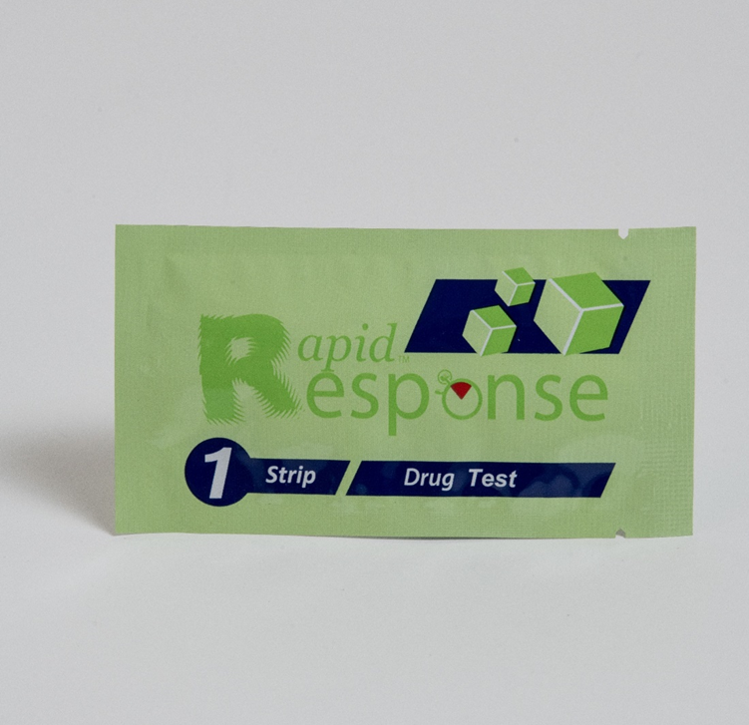
Fentanyl Test Strips Help Prevent Overdoses
Small strips of paper that can detect the presence of fentanyl in different kinds of drugs and drug forms
Chocolate Chip Cookie Effect: One portion of a drug may contain fentanyl while another does not
Local organizations distribute fentanyl test strips
Notes:
Fentanyl test strips (FTS) are a low-cost method of helping prevent drug overdoses and reduce harm.
FTS are small strips of paper that can detect the presence of fentanyl in all different kinds of drugs (cocaine, methamphetamine, heroin, etc.) and drug forms (pills, powder, and injectables).
Chocolate Chip Cookie effect: One portion of a drug may contain fentanyl while another does not
Look for organizations in your city or state that distribute FTS, keep them on you, and use them!
FTS Instructions:
Depending on the types of drugs you’re testing, the steps may be slightly different:
Step 1: Put a small amount (at least 10 mg) of your drugs aside in a clean, dry container.
Step 2: Add water to the container and mix together.
Please note: For most drugs, you need ½ teaspoon of water.
If you are testing methamphetamines, use 1 full teaspoon.4
Step 3: Place the wavy end of the test strip down in the water and let it absorb for about 15 seconds.
Step 4: Take the strip out of the water and place it on a flat surface for 2 to 5 minutes.
Step 5: Read the results.
Positive results: A single pink line on the left-hand side indicates that fentanyl or a fentanyl analog has been detected in your drugs. If you receive a positive result, it is much safer to discard the batch. Using it could kill you. Illicitly manufactured fentanyl is extremely potent and can be deadly.
Negative results: Two pink lines indicate that fentanyl or a fentanyl analog has not been detected in your drugs. Remember that no test is 100% accurate and your drugs may still contain fentanyl or fentanyl analogs even if you receive a negative result. You should still take caution as FTS might not detect more potent fentanyl-like drugs, like carfentanil, and fentanyl might not be everywhere in your drugs and your test might miss it.
Invalid results: A single pink line on the right-hand side or no lines at all, indicates an invalid test. If you get an invalid result, test your drugs again using a new strip.
Source:
https://www.cdc.gov/stopoverdose/fentanyl/fentanyl-test-strips.html

